Slide 1



CSYE6200 38559 Concepts of Object-Oriented Des SEC 05 Spring 2023
TEAM TALENT TROUPES
Project Name: Weather Application Using Java FX
Kunal Thapa
Sayali Hulle
Sakshi Pekale
Notes:
NOTE: Want a different image on this slide? Select the picture and delete it. Now click the Pictures icon in the placeholder to insert your own image.

Slide 2
INSPIRATION
Weather is an essential aspect of daily life.
It can be particularly useful for people who are on-the-go, such as travelers, hikers, or outdoor enthusiasts, as well as people who work in industries that are impacted by weather conditions, such as agriculture, construction, or transportation.
From a developer's perspective, creating a weather application can serve as a valuable learning experience.

Slide 3
TOOLS AND TECHNOLOGIES USED:
Eclipse IDE
JAVA Programming Language
JAVA FX
Scene Builder
Microsoft Office 365
Weather APIs like OpenWeatherMap, Weather Underground, or AccuWeather.

Slide 4
Scope of the Project
The scope of this project is to create a weather application using JavaFX. The application will allow users to enter a location and then retrieve the current weather data for that location from a weather API.
The application will display the weather data in a user-friendly way, using labels or other UI components to show the temperature, humidity, wind speed, and conditions.
The application will also handle any errors that may occur during the weather lookup, such as invalid input or network errors.
The application also provides the next 5 days forecast, wind speed, humidity, sun rise, and sun set timings along with the date and time that is completely dynamic.

Slide 5
Implementation and basic algorithm
Step 1 JavaFX UI
Create a JavaFX UI that includes:
Text fields for entering location or city.
Button to trigger the weather lookup.
Area to display results.
Step 2 Java Class
Define Java class to handle API
OpenWeatherMap / WeatherAPI
Create API requests and responses
Step 3 UI
Display weather data in UI.
Display icon and image to represent weather condition
Step 4 Error handling
Invalid input.
Network errors.
Parse the JSON response from the API
Data- temperature, humidity, wind speed
Display user friendly error message.

Slide 6
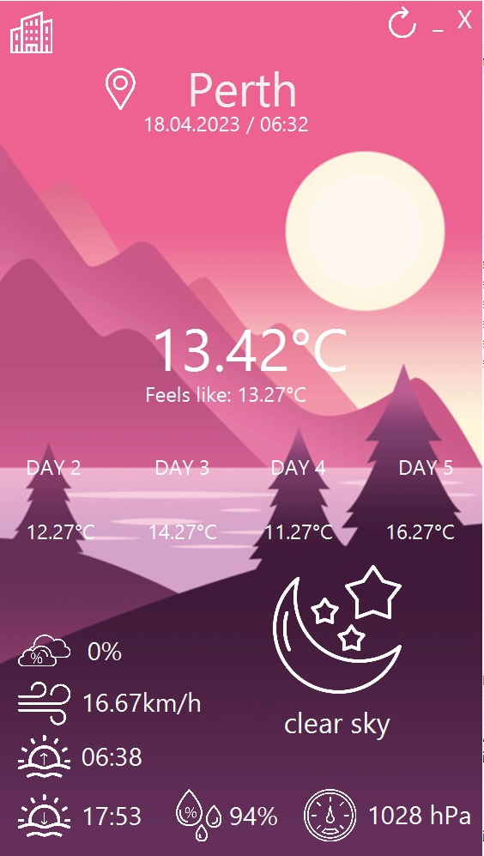
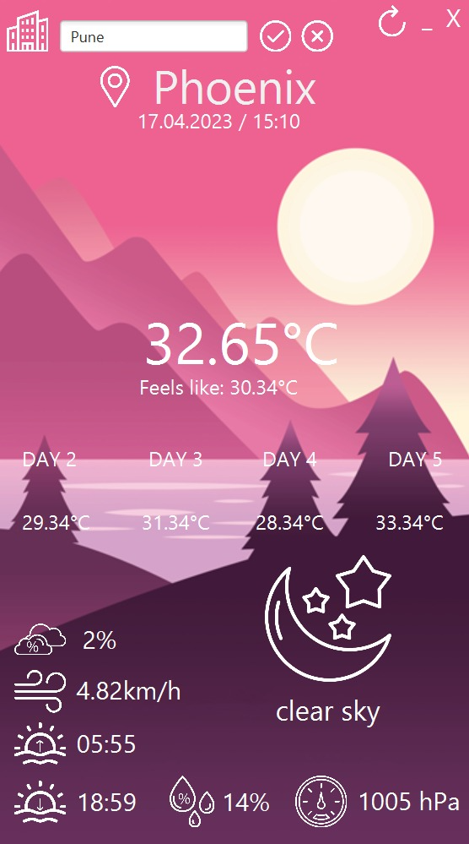
Weather forecast for morning and afternoon

Slide 7
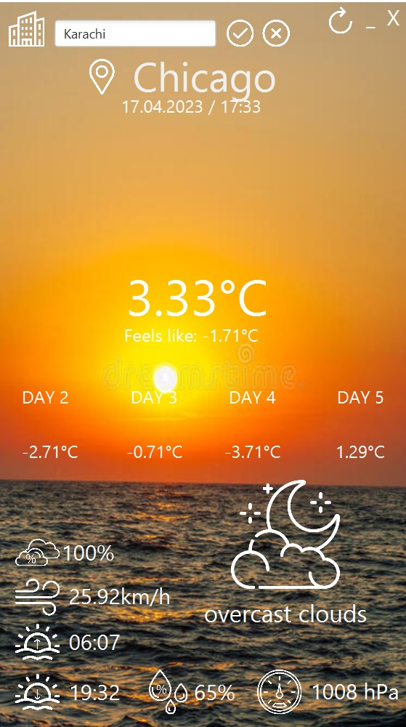
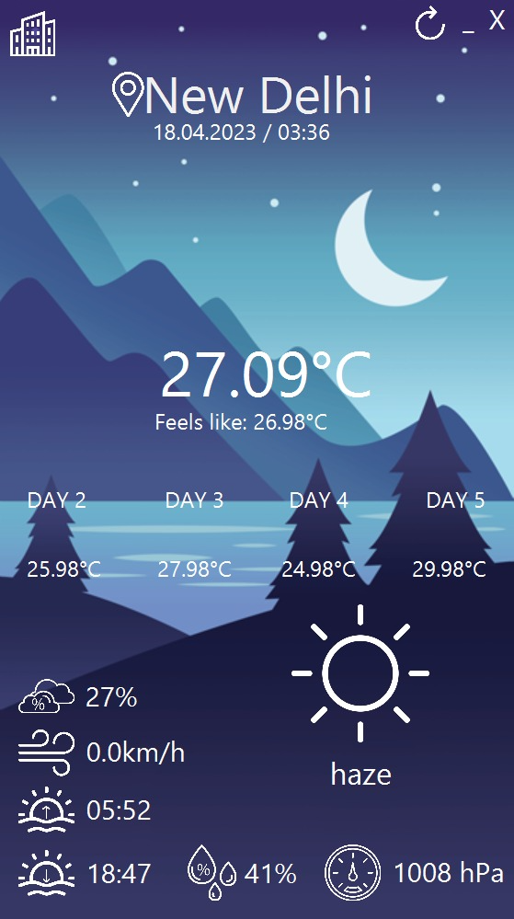
Weather forecast for evening and night

Slide 8
DEMO TIME!!

Slide 9

Conclusion and Outcome:
This project was aimed at creating a weather application using JavaFX that would allow users to retrieve and display current weather data for their location or a selected city.
The application was developed using the Java programming language and various tools such as Eclipse, GitHub, Scene Builder, Trello, Google Drive, Google Slides, and Microsoft Word.
The project team followed a basic algorithm that involved creating a user interface, defining a Java class to handle weather API requests and responses, parsing the JSON response from the API, displaying the weather data in the UI, handling errors, and adding optional features such as a weather forecast, search history, and units conversion.
By completing this project, the team gained valuable experience in Java programming, JavaFX, API integration, JSON parsing, error handling, and software development tools. The resulting weather application is a functional and useful tool that demonstrates the team's skills and knowledge in these areas.
Overall, this project was a great opportunity for the team to apply their knowledge and skills in a practical and real-world scenario, and it serves as a testament to the team's ability to develop useful and functional software applications.

